Slide 1
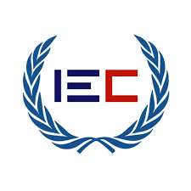
Real Estate Contract
Name: Muhammad Muzammil Hassan
Course: Blockchain
Cohort: 6

Slide 2
Problem Statement
Real estate in Pakistan as well as in many parts of the world is a very slow and cumbersome process.
There are also many intermediaries involved in the process of land registration.
Developing a system that not only accelerates the process of land registration, but also makes it easier for Buyers, Sellers and Government registrars to transfer the land ownership from seller to a new buyer, is only possible by creating a distributed system that stores all the transactions made during the process of land buying.

Slide 3
Advantages.
Prevent sale frauds
Resolve disputes
Make sure ownership is correctly transferred to a new ownership

Slide 4
Features
Buyer and seller both can register themselves.
Land Inspector can verify buyer and seller.
Verified Sellers can upload land details.
Land inspector can also verify land.
Seller details can be updated.
Land details and owner details can be viewed.

Slide 5
Features
Buyer details can be updated.
Buyer can buy a land.
Owner of the land can transfer land to anyone if that land is verified by land inspector.

